Slide 1

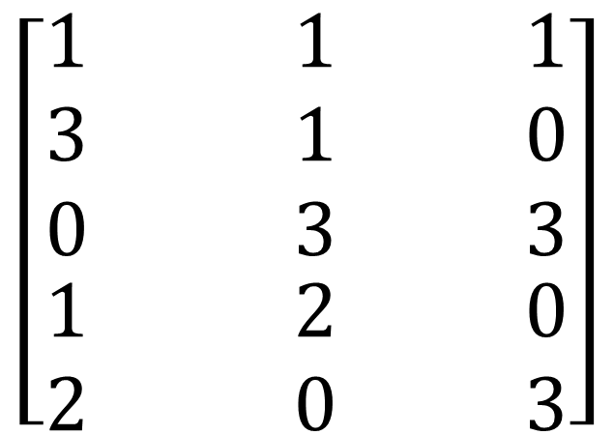
Y11 Apps Chapter 6 Example
An interschool sports carnival involves five schools competing in seven sports where points are awarded to teams finishing 1st, 2nd or 3rd.
The 5 x 3 matrix below shows the number of first second and third places by each school.
Suppose that points are awarded using the points system below:
1st
2nd
3rd
School A
$$\left[\begin{aligned}\begin{matrix}1 & 1 & 1 \\ 3 & 1 & 0 \\ 0 & 3 & 3\end{matrix} \\ \begin{matrix}1 & 2 & 0\end{matrix} \\ \begin{matrix}2 & 0 & 3\end{matrix}\end{aligned}\right]$$
$$\left[\begin{matrix}\begin{aligned}3 \\ \end{aligned} \\ \begin{aligned}2 \\ \end{aligned} \\ 1\end{matrix}\right]$$
1st Place
School B
School C
2nd Place
School D
School E
3rd Place

Slide 2
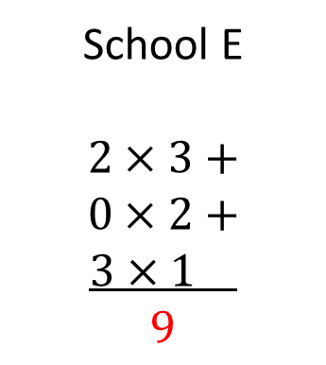

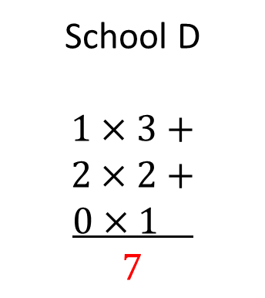

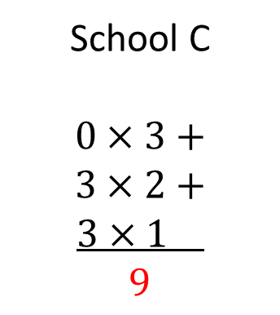
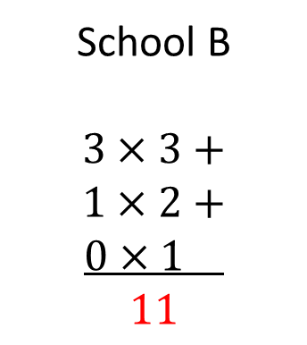
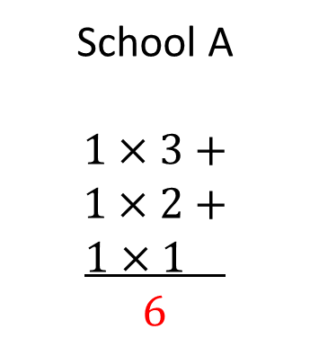
Y11 Apps Chapter 6 Example
1st
2nd
3rd
Each Row has been ‘stood up’ to align with the points matrix.
School A
$$\left[\begin{aligned}\begin{matrix}1 & 1 & 1 \\ 3 & 1 & 0 \\ 0 & 3 & 3\end{matrix} \\ \begin{matrix}1 & 2 & 0\end{matrix} \\ \begin{matrix}2 & 0 & 3\end{matrix}\end{aligned}\right]$$
$$\left[\begin{matrix}\begin{aligned}3 \\ \end{aligned} \\ \begin{aligned}2 \\ \end{aligned} \\ 1\end{matrix}\right]$$
1st Place
School B
This is how we multiply matrices!!!
Each Row x Each Column
School C
2nd Place
School D
School E
3rd Place
To Calculate the total points for each school we would use the following calculations:
School A
$$1×3+$$
$$1×2+$$
$$1×1$$
$$6$$
School B
$$3×3+$$
$$1×2+$$
$$0×1$$
$$11$$
School C
$$0×3+$$
$$3×2+$$
$$3×1$$
$$9$$
School D
$$1×3+$$
$$2×2+$$
$$0×1$$
$$7$$
School E
$$2×3+$$
$$0×2+$$
$$3×1$$
$$9$$

Slide 3
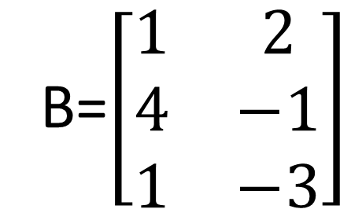
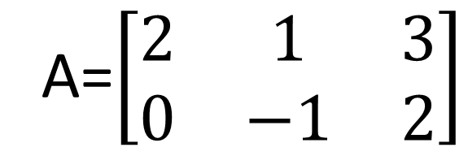
Y11 Apps Chapter 6 SKILL DEVELOPMENT
Two matrices can be multiplied together if the number of columns in the first matches the number of rows in the second.
B=$\left[\begin{matrix}1 & 2 \\ 4 & −1 \\ 1 & −3\end{matrix}\right]$
A=$\left[\begin{matrix}2 & 1 & 3 \\ 0 & −1 & 2\end{matrix}\right]$
2 x 3
3 x 2
The columns in the first matches the rows in the second, therefore matrix multiplication can be completed.

Slide 4
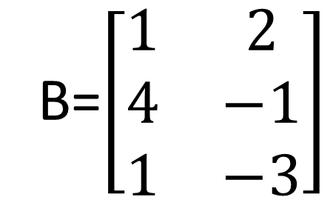
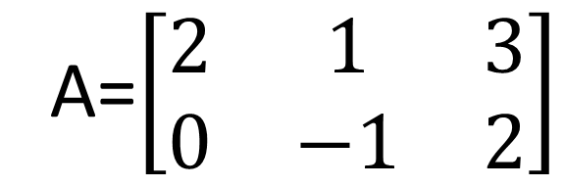

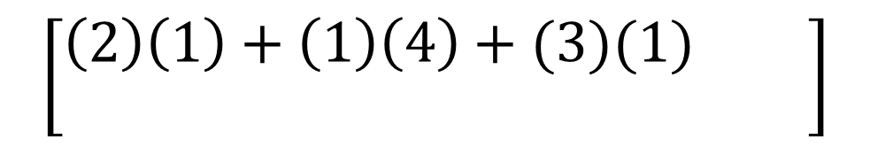
Y11 Apps Chapter 6 SKILL DEVELOPMENT
Determine the product AB
B=$\left[\begin{matrix}1 & 2 \\ 4 & −1 \\ 1 & −3\end{matrix}\right]$
A=$\left[\begin{matrix}2 & 1 & 3 \\ 0 & −1 & 2\end{matrix}\right]$
Spin the first row in A to align with the first column in B
Then multiply the corresponding numbers and sum the total
Repeat this process with each Row in A and each column in B.
$$\left[\begin{matrix}\left(2\right)\left(1\right)+\left(1\right)\left(4\right)+(3)(1) & \\ & \end{matrix}\right]$$
$$\left[\begin{matrix}9 & \\ & \end{matrix}\right]$$
Note how the product of the 1st row and 1st column is in the 1st row and 1st column of our final matrix

Slide 5

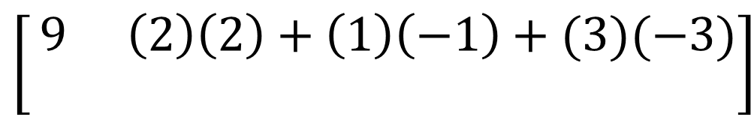
Y11 Apps Chapter 6 SKILL DEVELOPMENT
Determine the product AB
B=$\left[\begin{matrix}1 & 2 \\ 4 & −1 \\ 1 & −3\end{matrix}\right]$
A=$\left[\begin{matrix}2 & 1 & 3 \\ 0 & −1 & 2\end{matrix}\right]$
Spin the first row in A to align with the second column in B
Then multiply the corresponding numbers and sum the total
Repeat this process with each Row in A and each column in B.
$$\left[\begin{matrix}9 & \left(2\right)\left(2\right)+\left(1\right)\left(−1\right)+(3)(−3) \\ & \end{matrix}\right]$$
$$\left[\begin{matrix}9 & −6 \\ & \end{matrix}\right]$$
Note how the product of the 1st row and 2nd column is in the 1st row and 2nd column of our final matrix

Slide 6

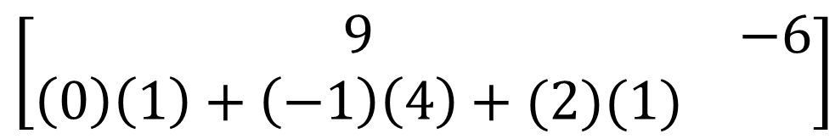
Y11 Apps Chapter 6 SKILL DEVELOPMENT
Determine the product AB
B=$\left[\begin{matrix}1 & 2 \\ 4 & −1 \\ 1 & −3\end{matrix}\right]$
A=$\left[\begin{matrix}2 & 1 & 3 \\ 0 & −1 & 2\end{matrix}\right]$
Spin the second row in A to align with the first column in B
Then multiply the corresponding numbers and sum the total
Repeat this process with each Row in A and each column in B.
$$\left[\begin{matrix}9 & −6 \\ \left(0\right)\left(1\right)+\left(−1\right)\left(4\right)+(2)(1) & \end{matrix}\right]$$
$$\left[\begin{matrix}9 & −6 \\ −2 & \end{matrix}\right]$$
Note how the product of the 2nd row and 1st column is in the 2nd row and 1st column of our final matrix

Slide 7

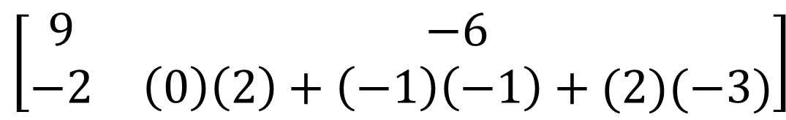
Y11 Apps Chapter 6 SKILL DEVELOPMENT
Could we determine the product BA??
Determine the product AB
B=$\left[\begin{matrix}1 & 2 \\ 4 & −1 \\ 1 & −3\end{matrix}\right]$
A=$\left[\begin{matrix}2 & 1 & 3 \\ 0 & −1 & 2\end{matrix}\right]$
B= 3x2 A= 2x3
Yes, the columns in B match up with the rows in A
Spin the second row in A to align with the second column in B
Then multiply the corresponding numbers and sum the total
$$\left[\begin{matrix}9 & −6 \\ −2 & \left(0\right)\left(2\right)+\left(−1\right)\left(−1\right)+(2)(−3)\end{matrix}\right]$$
$$\left[\begin{matrix}9 & −6 \\ −2 & −5\end{matrix}\right]$$
Note how the product of the 2nd row and 2nd column is in the 2nd row and 2nd column of our final matrix

Slide 8
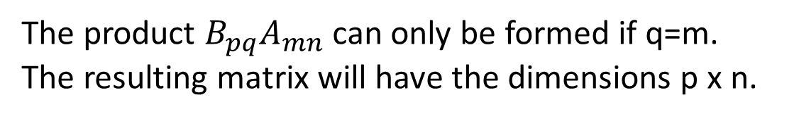
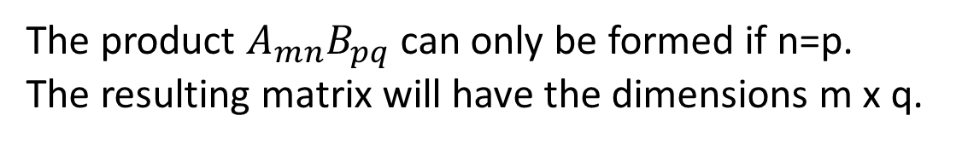
Y11 Apps Chapter 6 SKILL DEVELOPMENT
Two matrices can be multiplied together if the columns in the first equal the rows in the second.
Suppose that matrix A has ‘m x n’ dimensions and Matrix B has ‘p x q’ dimensions
The product $A_{mn}B_{pq}$ can only be formed if n=p.
The resulting matrix will have the dimensions m x q.
In the product AB we say that B is premultiplied by A
The product $B_{pq}A_{mn}$ can only be formed if q=m.
The resulting matrix will have the dimensions p x n.
In the product BA we say that B is postmultiplied by A
For example: A=2x3 and B= 1x2
AB= 2x3 1x2, cannot be done
BA= 1x2 2x3, possible and resulting matrix will be 1x3

Slide 9
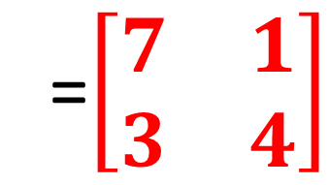
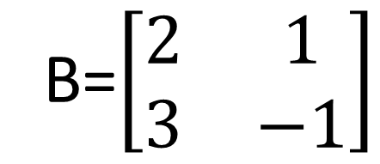
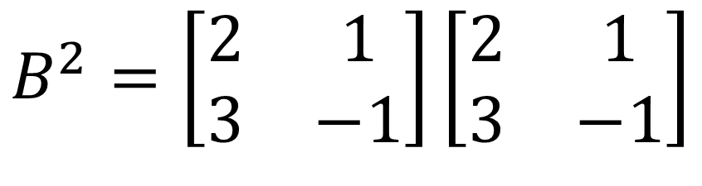
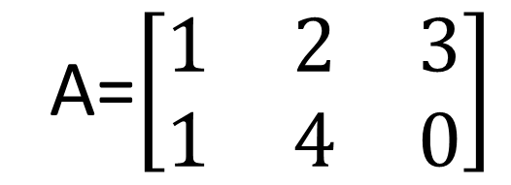
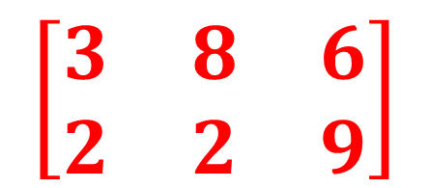
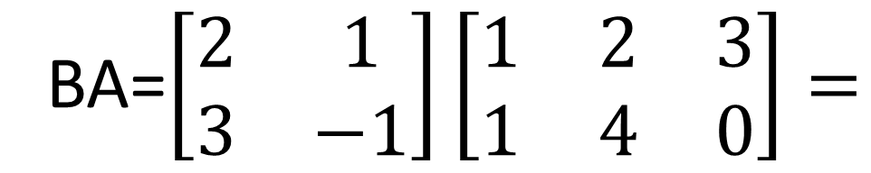
Y11 Apps Chapter 6 EXAMPLE 2
A=$\left[\begin{matrix}1 & 2 & 3 \\ 1 & 4 & 0\end{matrix}\right]$
B=$\left[\begin{matrix}2 & 1 \\ 3 & −1\end{matrix}\right]$
a) Determine the product AB
Cannot be determined as there are 3 columns in A but 2 rows in B, not equal
b) Determine the product BA
BA=$\left[\begin{matrix}2 & 1 \\ 3 & −1\end{matrix}\right]\left[\begin{matrix}1 & 2 & 3 \\ 1 & 4 & 0\end{matrix}\right]=$
$$\left[\begin{matrix}3 & 8 & 6 \\ 2 & 2 & 9\end{matrix}\right]$$
c) Determine the product $B^{2}$
$$B^{2}=\left[\begin{matrix}2 & 1 \\ 3 & −1\end{matrix}\right]\left[\begin{matrix}2 & 1 \\ 3 & −1\end{matrix}\right]$$
=$\left[\begin{matrix}7 & 1 \\ 3 & 4\end{matrix}\right]$

Slide 10
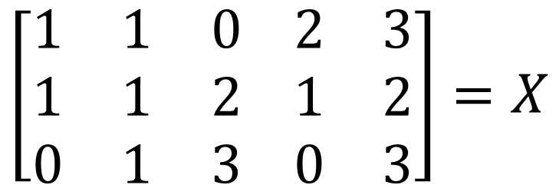
Y11 Apps Chapter 6 EXAMPLE 2
A manufacturer makes three products A, B and C, each requiring a certain number of units of commodities P, Q, R, S and T. Matrix X shows the number of units of each commodity required to make one of each product.
P
Q
R
S
T
Product A
$$\left[\begin{matrix}1 & 1 & 0 \\ 1 & 1 & 2 \\ 0 & 1 & 3\end{matrix}\begin{matrix} 2 & 3 \\ 1 & 2 \\ 0 & 3\end{matrix}\right]=X$$
Product B
Product C
a) Each unit of P, Q, R, S and T costs the manufacturer $200, $100, $50, $400 and $300 respectively. Write this information as matrix Y which should be either a column or row matrix, whichever can form a product with X.
b) Form the product referred to in a) and explain what information it displays

Slide 11

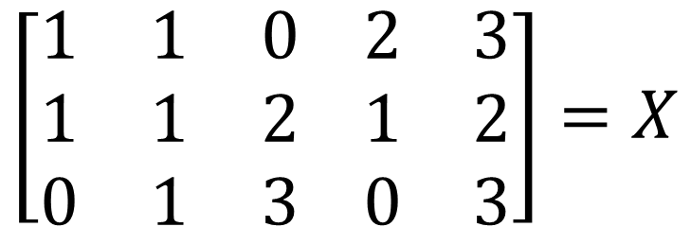
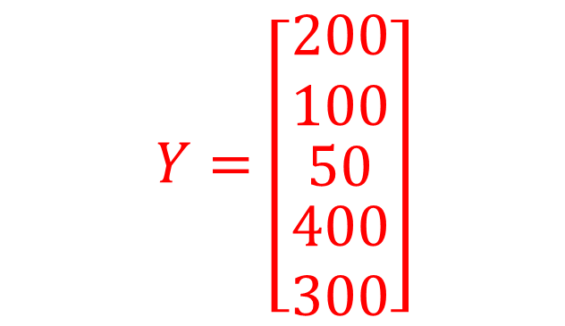
Y11 Apps Chapter 6 EXAMPLE 2
P
Q
R
S
T
a) Each unit of P, Q, R, S and T costs the manufacturer $200, $100, $50, $400 and $300 respectively. Write this information as matrix Y which should be either a column or row matrix, whichever can form a product with X.
Product A
$$\left[\begin{matrix}1 & 1 & 0 \\ 1 & 1 & 2 \\ 0 & 1 & 3\end{matrix}\begin{matrix} 2 & 3 \\ 1 & 2 \\ 0 & 3\end{matrix}\right]=X$$
Product B
Product C
Matrix Y needs to be either a 5 x 1 column matrix or a 1x 5 row matrix
Matrix X is a 3 x 5 and can therefore only form a product with Y if it is a 5 x 1 Column matrix
$$X_{3×5}×Y_{5×1}=Z_{3×1}$$
$$Y=\left[\begin{matrix}200 \\ 100 \\ \begin{matrix}50 \\ \begin{matrix}400 \\ 300\end{matrix}\end{matrix}\end{matrix}\right]$$
Cost of 1 unit of P
Cost of 1 unit of Q
Cost of 1 unit of R
Cost of 1 unit of S
Cost of 1 unit of T

Slide 12
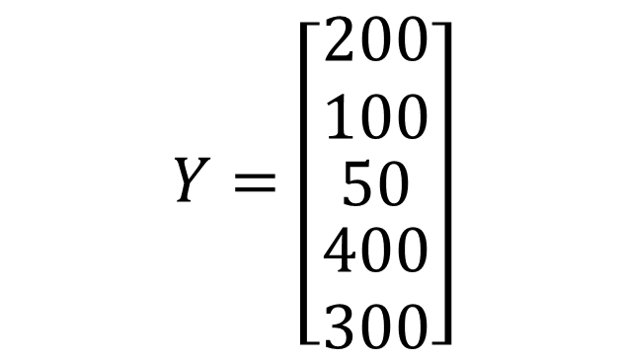
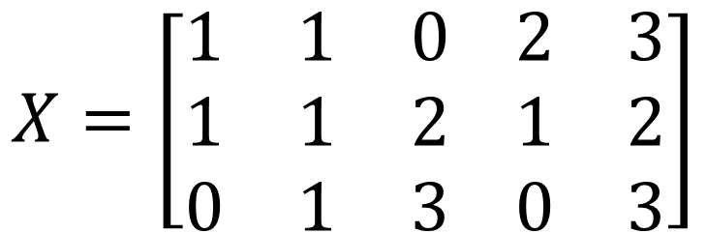

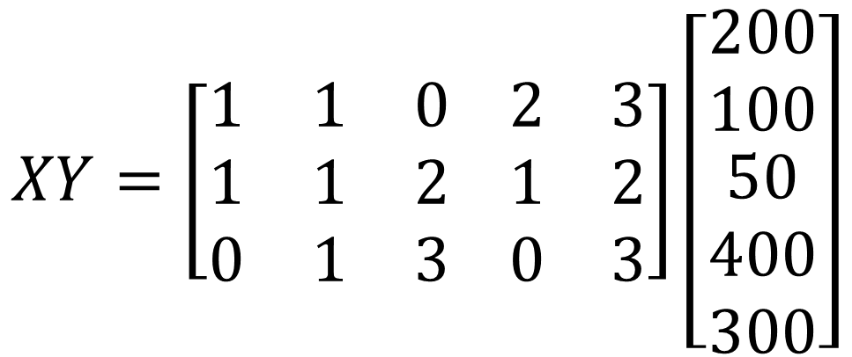
Y11 Apps Chapter 6 EXAMPLE 2
$$Y=\left[\begin{matrix}200 \\ 100 \\ \begin{matrix}50 \\ \begin{matrix}400 \\ 300\end{matrix}\end{matrix}\end{matrix}\right]$$
Now Try Ex 6B
$$X=\left[\begin{matrix}1 & 1 & 0 \\ 1 & 1 & 2 \\ 0 & 1 & 3\end{matrix}\begin{matrix} 2 & 3 \\ 1 & 2 \\ 0 & 3\end{matrix}\right]$$
b) Form the product referred to in a) and explain what information it displays
$$XY=\left[\begin{matrix}1 & 1 & 0 \\ 1 & 1 & 2 \\ 0 & 1 & 3\end{matrix}\begin{matrix} 2 & 3 \\ 1 & 2 \\ 0 & 3\end{matrix}\right]\left[\begin{matrix}200 \\ 100 \\ \begin{aligned}50 \\ 400 \\ 300\end{aligned}\end{matrix}\right]$$
$$=\left[\begin{matrix}2000 \\ 1400 \\ 1150\end{matrix}\right]$$
Total commodity cost ($) of producing 1 unit of each product. i.e. $2000 to produce product A

